Slide 1
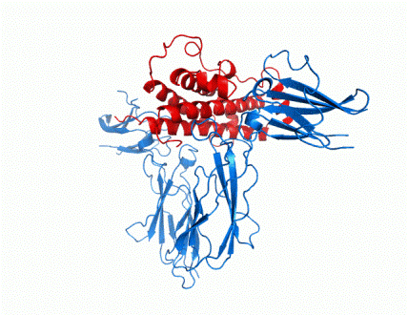


What’s Happening at GRS
News letter #1; March 1st, 2011
Visit: http://www.ghresearchsociety.org
GRS-IGF 2010 Meeting in NYC
  Oct. 3-7, 2010
  351 Attendees
  Student travel awards; 79 travel grants totaling $82,500 WOW!!
  Thanks to Derek LeRoith and the LOC and POC for putting together a great meeting!
  Selected Plenary Talks at the Meeting
  D. Sinclair: Longevity genes, parlor trick or path to drugs that revolutionize medicine
  D. Berryman: GH and fat distribution: To be and where to be
  M. Korbonitis: The curious case of Ghrelin
  R. Baxter: Who needs IGFs? IGFBP3 activates
  growth –stimulatory pathways
  B. Forbes; Molecular mechanisms underlying IGF action
  A. Lee: Targeting the IGF pathways in breast cancer
  M. Kjaer: Role of GH/IGF-1 in adaptation of matrix in skeletal muscle and tendon to exercise
  V. Longo: Conserved IGF-1 regulated genes and the prevention and treatment of age-related diseases
  D. Waxman: Genomic approaches to unraveling the complexity of GH-regulated liver sex differences
  M. Bidlingmaier: Diagnostic guidelines and GH assay variability
  M. Holzenberger: IGF-1 receptor in adults: What the cell-specific knockouts tell us
  S. Camper: Strategies for identifying genes involved in cell lineage specification and expansion: from stem cell to hormone producing cells.
Upcoming Events
  Prader-Willi Workshop
    Montreal, (Oct 3-6, 2011)
  GRS-IGF Meeting
    Munich (Oct 16-20, 2012)
    See advertisement below!!
  GRS-IGF Meeting
    Singapore (Oct 14-19, 2014)
  GRS-IGF Meeting
    (2016, TBD)
  Other Upcoming Workshops
    (dates TBD)
    IGF1 deficiency
    Safety of rhGH treatment

Slide 2






What’s Happening at GRS
Page 2
Visit: http://www.ghresearchsociety.org
Supporting Member News
GRS Council Supporting Member Meeting, NYC, Oct. 5, 2011
    A direct dialogue between GRS and Supporting Members was established during the recent NYC meeting which was quite valuable for its constructive input.
    GRS intends to continue and institutionalize these types of meetings.
  Supporting Member Sponsored Satellite Sessions at our Meetings Now Approved
    The timing of satellite meetings must not conflict with GRS meeting times
      They could occur before or after the GRS-IGF meeting or could be held as a breakfast meeting
    Host of the Satellite meeting will organize and support the entire event
    Speakers for the Satellite meeting must be submitted to GRS-IGF Program Organizing Committee for approval (so as not to conflict with speakers in the GHR-IGF Meeting)
  GRS thanks Supporting Members for your continued and enthusiastic support!
Check Out Our ‘Most Recent’
Consensus Statement!
Consensus Statement on the Standardization and Evaluation of Growth Hormone and Insulin like Growth Factor Assays.
D Clemmons.
Clin Chem. Feb 2. 2011 [E pub ahead of print]
Recent Publications
Growth Hormone Receptor Deficiency Is Associated with a Major Reduction in Pro-Aging Signaling, Cancer, and Diabetes in Humans. J Guevara-Aguirre, P Balasubramanian, M Guevara-Aguirre, M Wei, F Madia, C Cheng, D Hwang, A Martin-Montalvo, J Saavedra, S Ingles, R de Cabo, P Cohen, V Longo .
Science Tranlational Medicine, Vol 3, Issue 70, p 1-9, 2011 www.ScienceTranslationalMedicine.org
Antagonists of growth hormone-releasing hormone (GHRH) reduce prostate size in experimental benign prostatic hyperplasia. F Ricka, A Schallya, N Blocke, M Nadjic, K Szepeshazia,
M Zarandia,, I Vidaurrea,b, R Pereza, G Halmosa, and L Szalontaya.
Proc Natl Acad Sci U S A. Feb 14. 2011 [Epub ahead of print]
www.pnas.org/cgi/doi/10.1073/pnas
The growth hormone receptor: mechanism of activation and clinical implications. A Brooks & M Waters. Nature Reviews Endocrinology, 6, p.515-525), 2010

